Slide 1
DBMS PROJECT TOPIC: CAR RENTAL SYSTEM ------------------------------------
Name: ASHISH MISHRA
Roll No:21CSB0B05

Slide 2
INDEX
1. PROBLEM STATEMENTS
2. Entities
3. Relations
4. ER/EER Diagram
5.Relational Schema
6.1.Functional Dependencies
6.2. Final relational schema
7. SQL CODE FOR CREATION AND INSERTION :
8. PL/SQL CODE:
9. Conclusion

Slide 3
INTRODUCTION
Our objective is to produce a Car Rental system. Customer can rent a car based on make and a model. Our system provides customer to have different pick-up and drop off locations and will impose late fee if the rental car is returned beyond the return date and time. The Customers can purchase car rental insurance which is optional and can use upto one discount coupon to their final bill. Customers who have membership will be by default given a 15% discount in their final bill.

Slide 4
ENTITIES
CUSTOMER
CAR
CAR_CATEGORY
LOCATION
BOOKING
BILLING_DETAILS
DISCOUNT
CAR_RENTAL_INSURANCE
FOR DETAILED INFORMATION, REFER PDF..

Slide 5
CUSTOMER
: Customer will be the one who is using car rental system for reserving a car. He can be a member of the system or a non-member of the system. Member of the system will have membership id. Customer entity will store details like customer driving license number, email, address, name, and phone number.

Slide 6
CAR
Car entity will have list of cars available in the system. Each car will be associated with a car category and car will have attributes like make, model, mileage and registration number. Car will also have separate flag to check the availability of the car.

Slide 7
CAR_CATEGORY
Every car has a car category. Price is calculated based on the car category. Car category will have attributes like no of person, no of luggage’s, name, and cost per day and late fee per hour.

Slide 8
LOCATION
Location entity here denotes the pickup and drop off location of the car. Customer can pick up the car from the particular location and can have same or different drop off location. Location will have attributes like Location id, name and address.

Slide 9
BOOKING
Each car reservation will be monitored in the entity called booking. Booking will have attributes like booking id, from date and time of booking and due return date and time and actual return date and time of the booking, and booking status. This booking amount mi ght also include rental insurance and discount code.

Slide 10
BILLING_DETAILS
When a customer returns a car, a bill will be generated on the particular booking. Billing have attributes like Bill ID, bill date, bill status, total late fee, tax amount, and total amount.

Slide 11
DISCOUNT
Customer can apply discount code while the bill is generated. Each discount code has different discount percentage. Discount will have attributes like discount code, name, expiry date and discount percentage.

Slide 12
CAR RENTAL INSURANCE
Customer may already have car rental insurance or can buy one while booking the car. Car rental insurance will have attributes like insurance code, coverage type, name and cost per day.

Slide 13
RELATION
CAR TO CAR_CATEGORY
CAR TO LOCATION
BOOKING TO BILLING
BOOKING TO DISCOUNT
BOOKING TO CAR_RENTAL_INSURANCE
BOOKING TO PICK-UP LOCATION
BOOKING TO DROP LOCATION
CUSTOMER TO CAR TO BOOKING

Slide 14
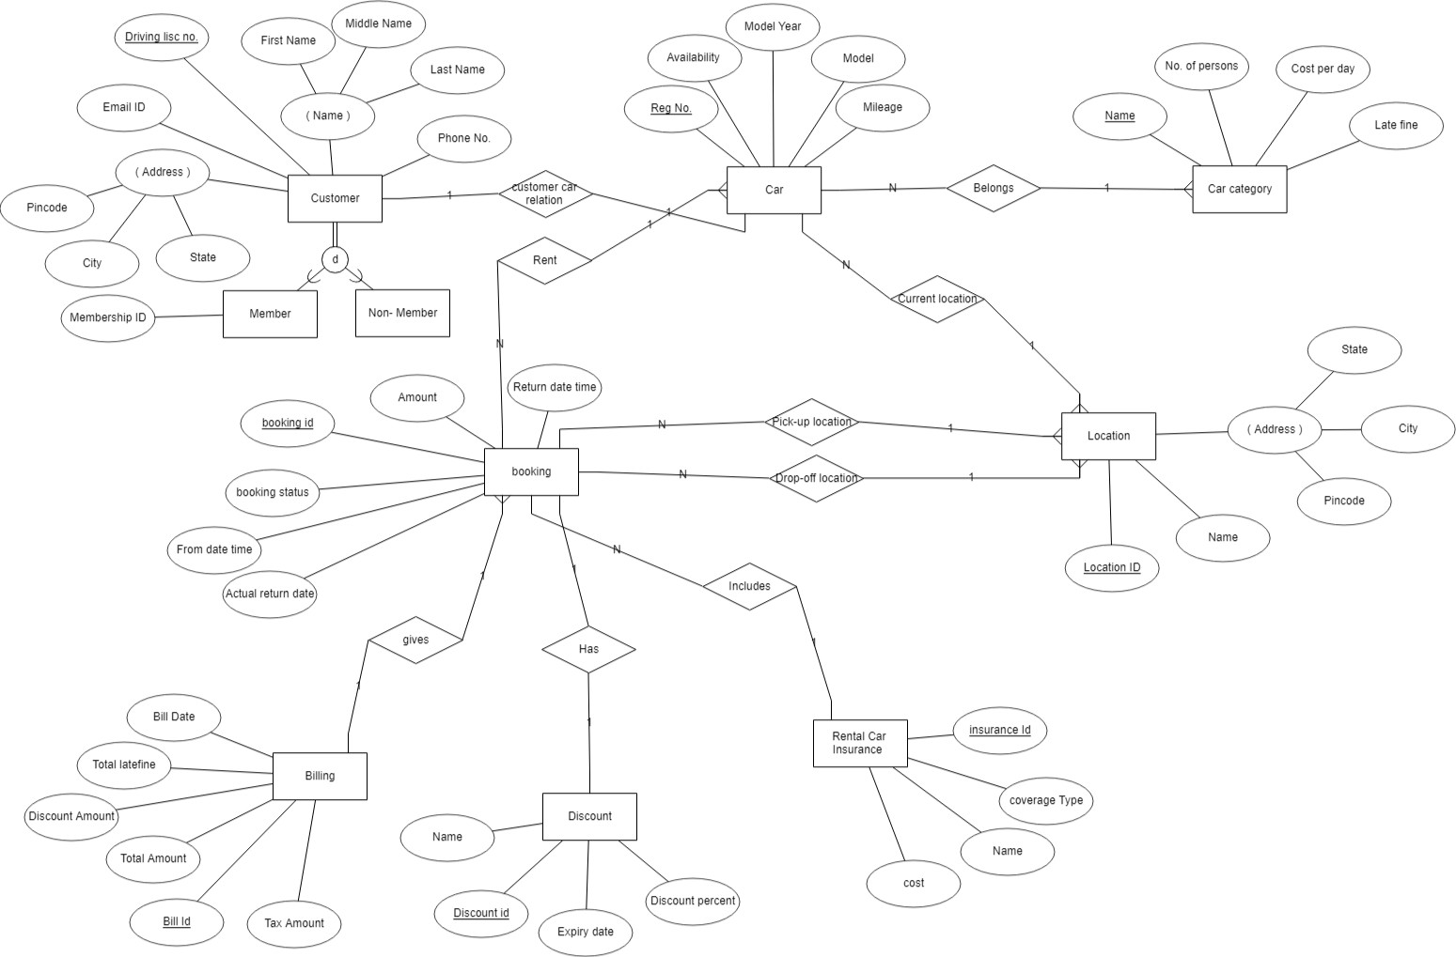
ER-DIAGRAM

Slide 15
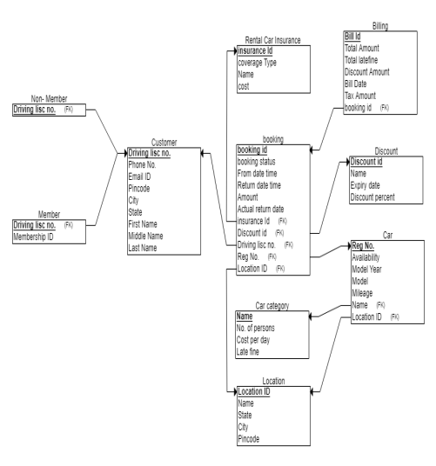
RELATIONAL SCHEMA

Slide 16
CONCLUSION
In this project we learnt the rules to construct a good ER diagram, How to come up with relational schema mapping from the ER diagram, deriving the functional dependencies and how to normalize the relational schema. We learnt on how to design a system from Database perspective and how to efficiently store and manipulate data.

